Slide 1


Slide 2
5 Most Common Kitchen Accidents/Concerns for Safety
  Burns
  Fires
  Falls
  Cuts
  Poisoning

Slide 3
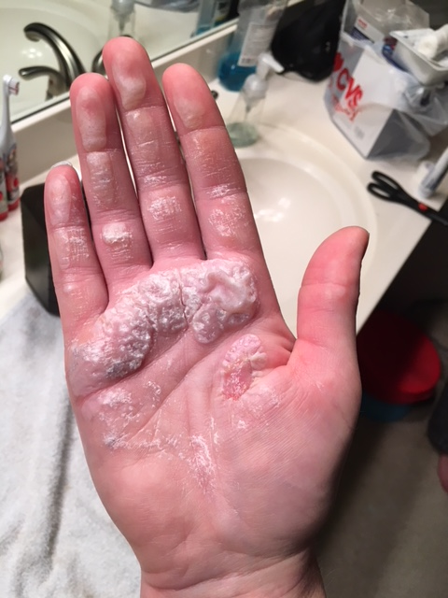
1. Burns
  Causes
    Water boils at what temperature? 212 degrees F
    Steam rises from a pan/pot at what temperature? 240-250 degrees F
    Scalding can occur with steam & boiling liquid

Slide 4
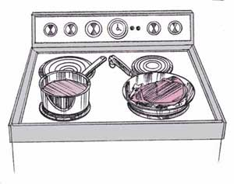
  BURN Prevention
    Turn pan handles toward the center or side of the range.
    Use dry, clean pot holders (no WET potholders!!!)
    Never use something else as a potholder
    Turn stove & oven off when finished
    Keep children away from stove

Slide 5
  Microwave BURNS
    Foods will be hot when removed – be careful!
    Stir and rotate foods in the microwave
    Don’t use metal in the microwave
    Make sure containers are microwave safe

Slide 6
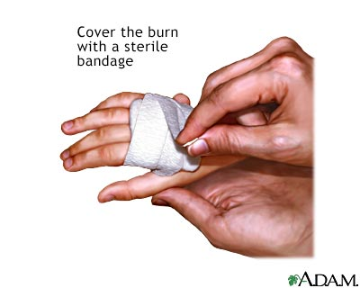
  BURN First Aid
    Cool as quickly as possible
      Place in or under cool water…not ICE COLD
    Cover with a dry bandage
    Don’t break blisters
    Call doctor if burn is extreme
    DO NOT USE OINTMENTS, SALVE, OR BUTTER

Slide 7
2. FIRES
  Prevention
    Don’t leave items like towels and potholders/oven mitts too close to the stove.
    Never leave food unattended.
    Grease Fire – what to do:
    Turn off the burner
    Take off the pot/pan from the burner
    Smother with damp towel, pan lid, baking soda, or salt (4 things)
    ***** Do NOT USE water – it will cause the fire to spread!

Slide 8
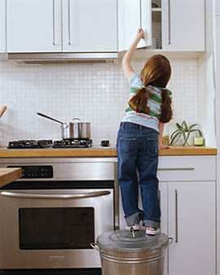
3. FALLS
  Prevention
    Wipe up spills RIGHT AWAY
    Keep traffic areas free from objects that may block the way.
    Walk in the kitchen
    Check for loose clothing
    (i.e., shoelaces, jewelry)

Slide 9
FALL First Aid
  Signs of concussion: headache, confusion, nausea, loss of consciousness, changes in vision & hearing.
  Call the Doctor
  Signs of fracture: deformity, point tenderness, bruising, swelling, inability to move hand or foot.
  Call the Doctor

Slide 10

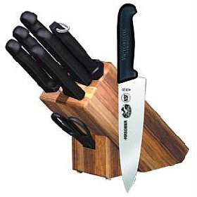
4. CUTS
  Prevention
    Use sharp knives instead of dull knives
    Store knives away from other utensils
    ALWAYS cut AWAY from you and your fingers
    NEVER dump knives into a sink – set them beside the sink and wash them one at a time.
    Broken glass- tell your teacher first! Sweep up the larger pieces to throw away. Use a wet paper towel to wipe up smaller slivers.

Slide 11

CUTS First Aid
  Wash gently & thoroughly
  Apply antiseptic ointment
  Wrap with a bandage or guaze

Slide 12
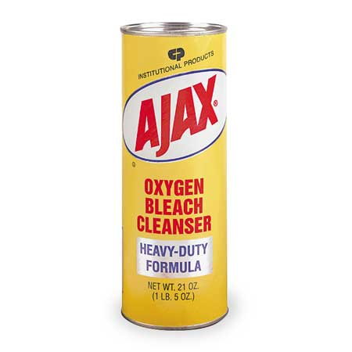
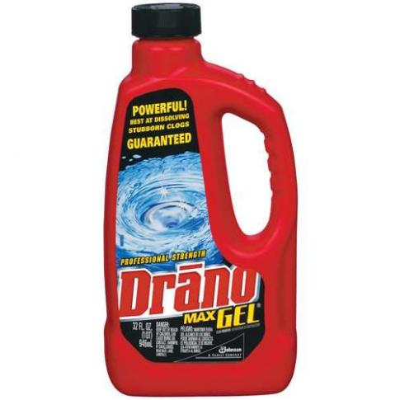
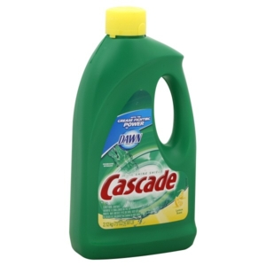
5. POISONING
  Prevention
    CLEAN
    SEPARATE
    COOK
    CHILL
    Also, be aware of harsh kitchen chemicals children may be able to reach.

Slide 13
POISONING Prevention
Clean
  wash hands in warm soapy water for 20 seconds
  Cover coughs and sneezes
  Clean and sanitize all surfaces in hot water
  Change towels often
  Washing dishes:
    Step 1: scrape extra food into trash
    Step 2: wash in hot soapy water
    Step 3: Rinse soap from dish
    Step 4: dry and put away

Slide 14
POISONING Prevention
Separate
  Separate cooked and ready-to-eat foods from raw foods.
  Do not taste and cook with the same spoon.
  Never use the same utensils, cutting board, or plate for raw and cooked foods. This prevents cross-contamination.

Slide 15
POISONING Prevention
Cook
  Food is safely cooked when it reaches a high enough internal temperature to kill harmful bacteria which can cause illness.
    Chicken: 165 degrees
    Beef: 160 degrees
    Fish: 145 degrees
    Pork: 145 degrees

Slide 16
POISONING Prevention
Chill
  Do not allow food to sit out longer than 2 hours.
  Refrigerators should be kept at 40 degrees F or below
  Freezers should be kept at 0 degrees F or below.
  Thaw food in refrigerator, cold water or microwave
  When in doubt “throw it out”

Slide 17

Use this test:
Does it LOOK good?
Does it SMELL good?
For the very brave … Does it TASTE good?
If answering NO to these … DON’T EAT or DRINK IT!! Bleh!

Slide 18
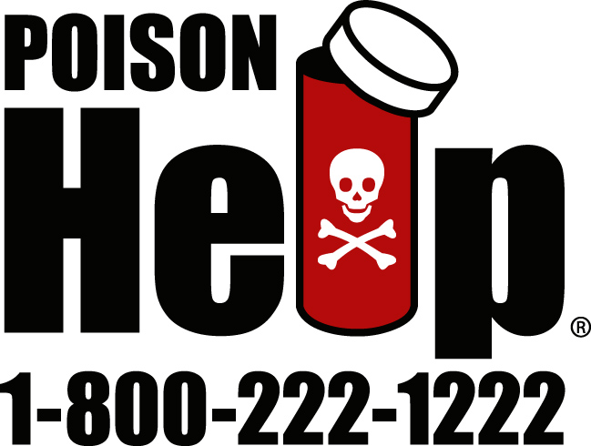
CHEMICAL POISONING First Aid
  Call poison control and tell them what the substance was that was inhaled or ingested.
  Follow their instructions

Slide 19
FOOD LAB RULES
  TIME MANAGEMENT is important! If you don’t finish your lab before the bell rings you will be tardy for next class.
  Failure to follow these rules my result in NO food lab:
Wash hands before doing anything then set up wash station
Read and follow recipe
Stay in your assigned kitchen
No horseplay/running
Completely wash, rinse, dry and put away dishes
Clean your lab area (floor, counter, sink)
Longer hair MUST be tied back before leaving desk (food lab)

